Slide 1

MACHINE
INTELLIGENCE
EXPECTATION MAXIMIZATION
K.S.Srinivas
Department of Computer Science and Engineering

Slide 2
MACHINE
INTELLIGENCE
EXPECTATION MAXIMIZATION
K.S.Srinivas
Department of Computer Science
and Engineering

Slide 3

Machine Intelligence
Unit III
Expectation Maximization
Srinivas K.S
Department of Computer Science

Slide 4

Expectation Maximization
Maximum likelihood estimation is an approach to density estimation for a dataset by searching across probability distributions and their parameters.
It is a general and effective approach that underlies many machine learning algorithms, although it requires that the training dataset is complete, e.g. all relevant interacting random variables are present.
Maximum likelihood becomes intractable if there are variables that interact with those in the dataset but were hidden or not observed, so-called latent variables.
The expectation-maximization algorithm is an approach for performing maximum likelihood estimation in the presence of latent variables
It does this by f
estimating the values for the latent variables, (E)
then optimizing the model(M),
then repeating these two steps until convergence.

Slide 5
Unsupervised Learning and EM
A central application of unsupervised learning is in the field of density estimation.
We will cover unsupervised learning in Unit 4 some 8 hours from now – but lets understand one of the simplest unsupervised learning algorithm to set the context for expectation maximization
K-Means clustering

Slide 6
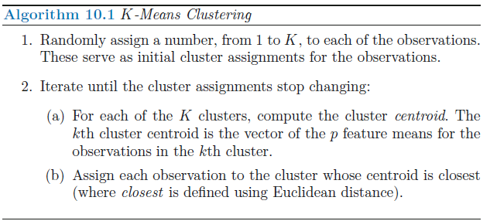

K-Means Clustering
K-means clustering is a simple and elegant approach for partitioning a data set into K distinct, non-overlapping clusters.
To perform K-means clustering, we must first specify the desired number of clusters K
K-means algorithm will assign each observation to exactly one of the K clusters

Slide 7
K-Means Clustering
Let C1, . . ., CK denote sets containing the indices of the observations in each cluster
They must satisfy 2 properties
1. C1 ∪ C2 ∪ . . . ∪ CK = {1, . . ., n}. In other words, each observation
belongs to at least one of the K clusters.
2. Ck ∩ Ck’ = ∅ for all k = k’. In other words, the clusters are nonoverlapping: no observation belongs to more than one cluster.

Slide 8
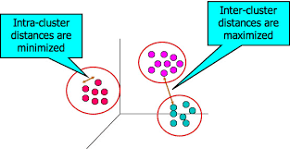


K-Means Clustering
The idea behind K-means clustering is that a good clustering is one for which the within-cluster variation is as small as possible.
The within-cluster variation for cluster Ck is a measure W(Ck) of the amount by which the observations within a cluster differ from each other.
In words, this formula says that we want to partition the observations into K clusters such that the total within-cluster variation, summed over all K clusters, is as small as possible
The intra-cluster distance is measured using the Euclidian distance between pair wise instances in the cluster

Slide 9
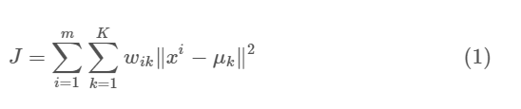
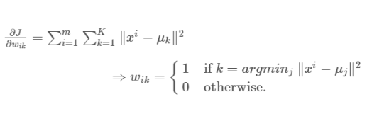
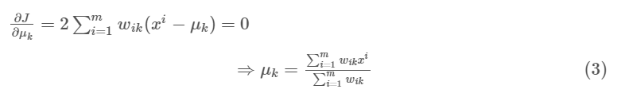
Expectation Maximization of K-Means
The E-step is assigning the data points to the closest cluster.
The M-step is computing the centroid of each cluster.
Lets prove that convergence is guaranteed
E-Step
where wik=1 for data point xi if it belongs to cluster k; otherwise, wik=0
M-Step

Slide 10

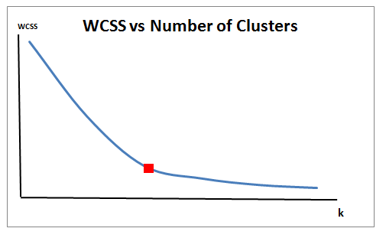
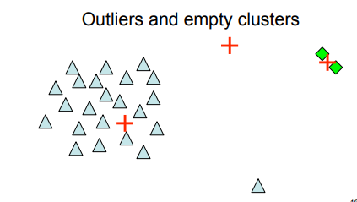
A normal distribution such that the mean μ = 0 and standard deviation σ = 1; hence, the probability density function f(x) is given by
Closing Notes on K-Means
A normal distribution such that the mean μ = 0 and standard deviation σ = 1 for your data
K-Means algorithm converges to a local minimum:
○ Can try multiple random restarts

Slide 11
Expectation Maximization
In the expectation, or E-step, the missing data are estimated given the
observed data and
current estimate of the model parameters
In the maximization or the M-step, the likelihood function is maximized
under the assumption that the missing data are known
The estimate of the missing data from the E-step are used in lieu of the actual missing data.

Slide 12
THANK YOU
Srinivas K S
Department of Computer Science & Engineering
srinivasks@pes.edu

